Slide 1
CASE STUDY : CYCLISTIC – BIKE SHARE CO.
By Altmash Bagwan
In this case study we have analyzed the data of Cyclist - Bike share co. and got insights on user behavior. To help marketing team to launch a data driven marketing campaign for company.
Notes:
In this case study we have analyzed the data of Cyclist - Bike share co. and got insights on in user behavior. To help marketing team to launch a data driven marketing campaign for company.

Slide 2
CASE OVERVIEW
Earlier Marketing approach
Building general awareness and appealing to broad consumer segments and Marketing flexible pricing plans for customers
User Base
Customers who purchase single-ride or full-day passes are referred to as casual riders. Customers who purchase annual memberships are Cyclistic members Cyclistic’s finance analysts have concluded that annual members are much more profitable than casual riders.
New Marketing Approach
Rather than creating a marketing campaign that targets all-new customers, Launch marketing to convert casual riders into members.
Notes:
Building general awareness and appealing to broad consumer segments : that helped make these things possible was the flexibility of its pricing plans: single-ride passes, full-day passes, and annual memberships.
Cyclistic’s finance analysts have concluded that annual members are much more profitable than casual riders.
Company’s marketing director beliveles : Although the pricing flexibility helps Cyclistic attract more customers, Moreno believes that maximizing the number of annual members will be key to future growth. Rather than creating a marketing campaign that targets all-new customers : Launch New campaign to convert new Marketing campaign

Slide 3
PROBLEM STATEMENT
To analyze the user data and find out difference between “Causal” & “Annual Member” user behavior .
To find out from trend “What could motivate the “casual” users to change to an annual subscription based on their behavior ?”

Slide 4
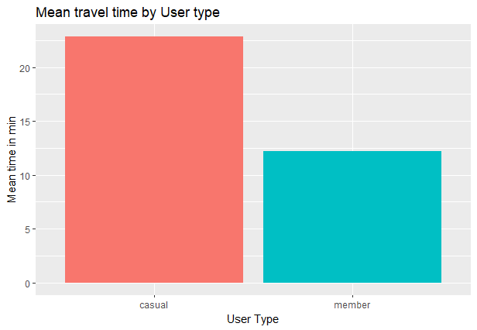
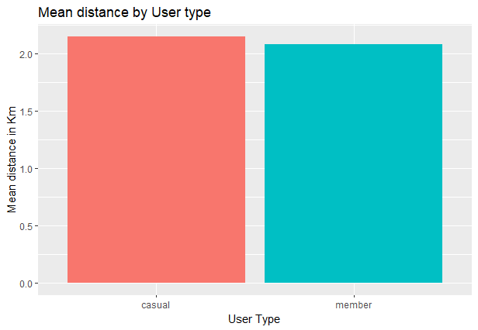
IDENTIFY TRENDS AND RELATIONSHIP
LONGER RIDE
ALMOST SAME AVG DISTANCE TRAVELLED
Notes:
It seems that the casual users travel the almost same average distance than the member users, but they have much longer rides, that would indicate a more leisure oriented usage vs a more “public transport” or pragmatic use of the bikes by the annual members.

Slide 5
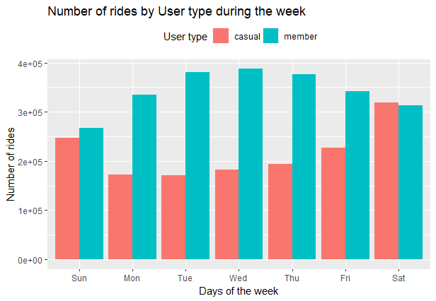
CASUAL RIDER HAVE MORE OF WEEKEND USAGE VS ANNUAL MEMBER RIDER HAVE STABLE USAGE OF SERVICE
Notes:
Idea is reinforced by the fact that annual users have a very stable use of the service during the week, but the casual users are more of a weekend user.

Slide 6
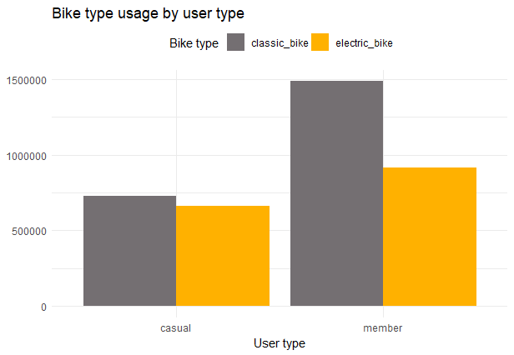
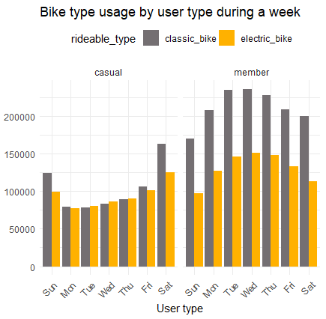
CLASSIC BIKE IS POPULAR AMONG ANNUAL MEMBER RIDER BUT CAUSAL RIDER USES BOTH
Notes:
Here we can see that the casual members use both types of bikes for their rides, but the member users show a higher preference for the Classic bikes.
On a weekly basis we can see that for the casual members there is a small difference of usage in weekdays where as on weekend difference is higher and preferred to use classic bike more. Also on weekend there is high usages compare to weekdays.
For the member users we see the usage on weekdays is more and on weekends it much less. Preference to choose bike remains same in all days of week.

Slide 7
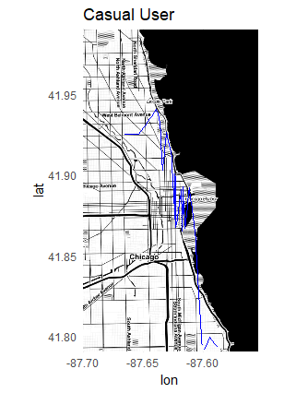
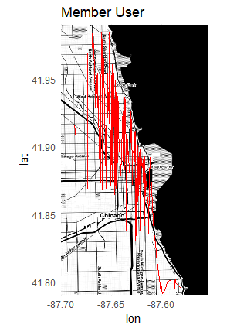
RIDE PATHS ACROSS CITY
Notes:
The coordinates data resulted to be very interesting, as we can clearly see the casual is usually located around the center of the town, with all their trips located around that area which makes sense given that they have a more relaxed leisure rides, on weekends probably also tourist or sightseeing related rides, that naturally focus more on the downtown area where most of the interest points are.
This contrasts heavily with the longer range of the member users that connect the downtown with the outskirts of the city as well, that would suggest they are mostly people that live outside the downtown and use the service to commute for their daily work in various part of city.

Slide 8
CONCLUSIONS
Data suggest that Casual riders have leisure and turism rides and are more often on weekend . Their Usage is mostly around city centre
The Annual member riders have commute or pragmatic rides, during all days of week. In fact on weekdays have more rides . They prefer classic bikes more then electric bike.

Slide 9
RECOMMENDATION
THEMES
PROMOTION
To focus marketing campaign on leisure and health aspect
Promoting classic bikes for health benefits and Electric bikes for longer routes usage.
USER FRIENDLY
Design the tiered membership with user customization like weekend usage or routes

Slide 10
THANK YOU
Altmash Bagwan
+91 7028-78-7774
altmashb22@live.com
www.linkedin.com/in/altmashbagwan

